Slide 1

Watch Video
Call : +91 9629754500
Email: contact@codeshoppy.com

Slide 2
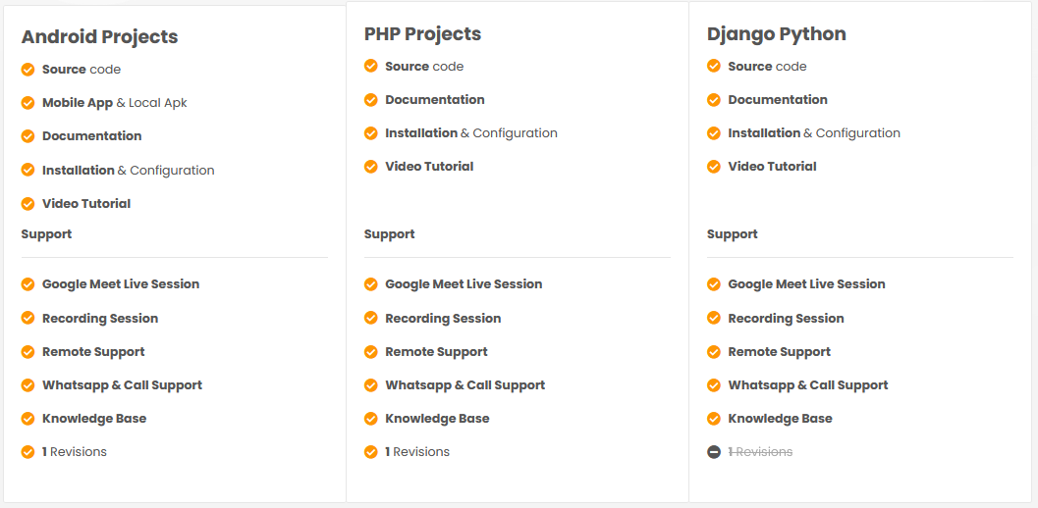

Slide 3
COLLEGE MANAGEMENT SYSTEM

Slide 4
AIM OF THE PROJECT
An Android and Web application for college is an application that can be accessed throughout the organization and especially by students well with proper login provided when needed.
Using college management application students will able to stay updated with their Mark results, sports, placement, college events, circular notice
An web and mobile based college campus to share the college campus activities application will provide updates to the students of their respective departments, notices regarding the recruiting company, campus interview date and other placement activities.
Using college management application system you can manage all information of all aspects of a college, its students, faculties, Departments, marks and other curricular activities.

Slide 5
OBJECTIVE OF THIS PROJECT
This college management application system facilitates colleges to maintain the functionality related to college employees and their students.
Providing a smart technology college management system.
College management system provides the easiest way to manage all functionalities of a college.
This application will help to reduce wasting college administration and faculties time for manage the all student information.
The majority of the population/ organization today uses smart phones with active internet connection, which is the basic requirement for this product to function properly.
This project falls under the category of embedded systems and android applications

Slide 6

SOFTWARE AND HARDWARE REQUIREMENTS
HARDWARE REQUIREMENTS:
Processor : intel pentium iv 1.8 ghz
Motherboard : intel 915gvsr chipset board
Ram : 1 gb ddr2 ram
Hard disk drive : 160 gb
SOFTWARE REQUIREMENTS:
Front end : html5, css3, bootstrap
Back end : php, mysql
Control end : angular java script
PHP TOOLS:
xampp-win32-5.5.19-0-VC11
ANDROID TOOLS:
Android Emulator
xampp-win32-5.5.19-0-VC11
Android SDK - adt-bundle-windows-x86

Slide 7
EXISTING SYSTEM
Due to the raise of benefits of automated system, huge process which done by the humans are automated now.
In college management existing system, there is a huge necessity needed for automated system which includes their role in academic infrastructures like schools & colleges that needs to change the role of their manual system to mobile computing systems.
The Computer Technology changes uses the databases & application of the Information System of students, which helps to make their documents and records as centralized.
It is not easy to find out the particular student information from whole record of college data management.

Slide 8
DISADVANTAGES OF EXISTING SYSTEM
Its manual process for earlier system.
Its more time consume for all process.
Need for more resources.
Its chance to lose our record or data.

Slide 9
PROPOSED SYSTEM
Mobile and Web application technology is beneficial for college management system.
The proposed system consists of three modules: admin panel, Student module. Admin can post their notification about collage, update staff details, student details and collage event details.
Students can view all details including staff details.
The proposed system Through this, the management and monitoring of students and school would be much easier for both college admin and teachers.

Slide 10
ADVANTAGES OF PROPOSED SYSTEM
Easy updates of mark results on mobile app
Provides an easy platform for student interaction.
Easy and fast updating of notices and events for better communication between students and administration.
Updating regarding events, conference, placement, results, files
Updating of recent notices and upcoming events.

Slide 11
MODULE LIST
ADMIN:
Login
View student details
STAFF/ FACULTY
Register
Login
Update staff details
Add student details
Update event details
Update placement details
Update attendance details
Post result details
Share file

Slide 12
MODULE LIST
STUDENT
Login
View staff details
View notification
View personal details
View result
Download file

Slide 13
USECASE DIAGRAMS
USER/ STUDENT

Slide 14
STAFF/ FACULITY

Slide 15
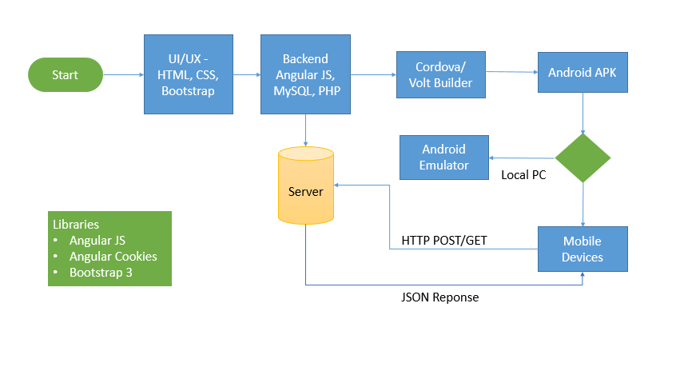
WORK FLOW DIAGRAM FOR ANDROID

Slide 16
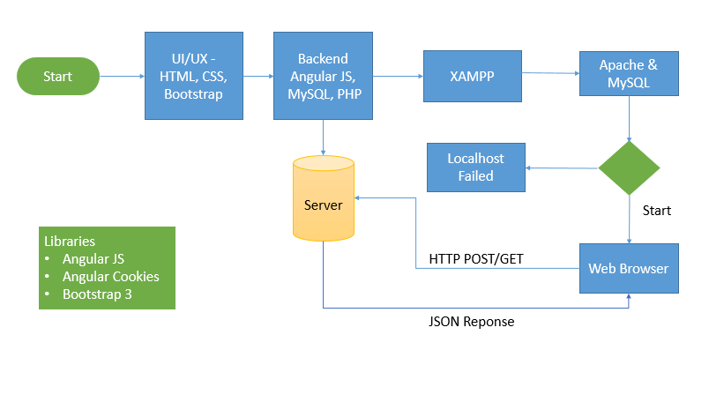
WORK FLOW DIAGRAM FOR WEB APPLICATION

Slide 17
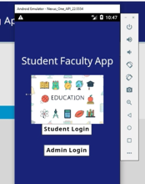
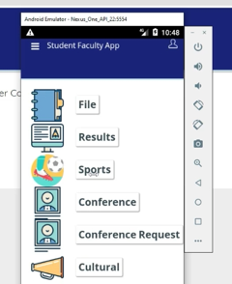
SCREENSHOTS

Slide 18
CONCLUSION
The project entitled as College Management System is the system that deals with the information of all student details
System leads to instant updates for all student any where physical.
Its also connect to parent about the ongoing progess in college/school

Slide 19
FUTURE ENHANCEMENT
In Future work, This application to develop a cross platforms like IOS, etc.
In adding the more features of college management system to develop access with user’s flexibility.
To authenticate the users based on the system users list which is maintained by the operating system
To restrict the usage of all files by the users based on their privileges on the system

Slide 20
REFERNECES
Drucker, Peter, F., 1981. Management: Tasks, Responsibilities and Practices, Allied Publishers, New Delhi.
Hodgets, Richard M., 1986, Management Theory: process and Practice, Academic Press, London.
Stoner, James. A.F. and Freeman.E.R., 1989. Management, Prentice Hall of India, New Delhi.
Katz R.L., 1974. Skills of an Effective Administrator, Harvard Business Review, 52(5) 90- 102.
Newman, William Hsummer, Charles E. and Warren, E, 1974. The Process of Management: Concepts, Behaviour and Practice, Prentice Hall of India; New Delhi.

